Slide 1
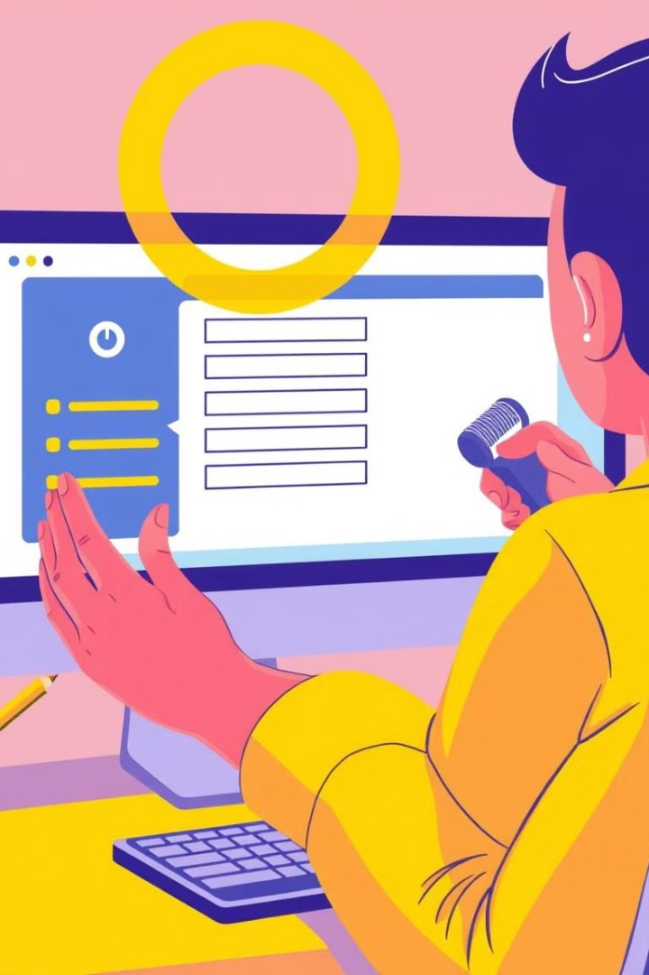
Beyond QWERTY: Voice- Enabled Bank Form Application
BY:
Aryan Jathar
Anumeha Anand
NikhilSingh
Priyanshu Raj
Awaz Bhujel
Rabi Panda
Abhirami Raji

Slide 2

Problem Statement
Time-Consuming
Error-Prone
Accessibility Barriers
Manual form filling is slow and inefficient.
Manual data entry is prone to errors, causing inaccuracies and wasted time.
Typing challenges hinder access to forms and services for people with disabilities.

Slide 3
Solution Overview
Voice Command Form Filling
Users can fill out forms by voice, reducing typing and errors.
Reduces Errors and Language Barriers
Voice recognition enables natural input, reducing errors and increasing accessibility.
Automatic PDF Generation
The system auto-generates PDFs, ensuring efficient and organized output.

Slide 4
Key Features
Secure Authentication
Speech Recognition Engine
Natural Language Processing
Interprets and understands the meaning of spoken language, allowing for natural interactions.
A robust authentication system ensures the safety and privacy of user data.
A powerful engine that accurately converts spoken words into text.

Slide 5
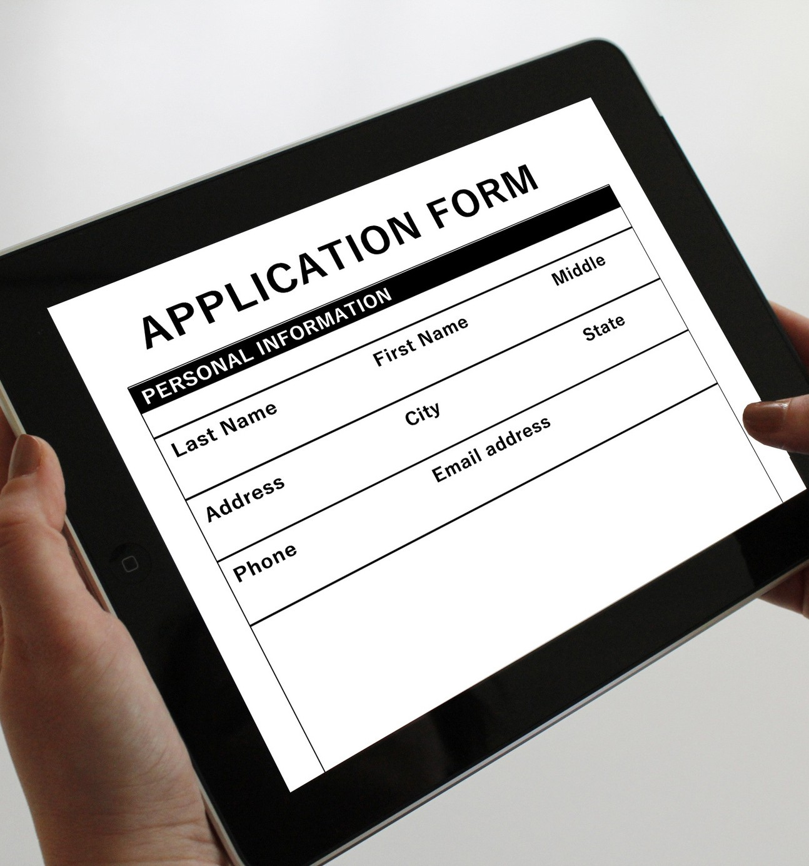
Real-Time Form Validation
Ensures data accuracy by verifying the information as it is being entered.
Automated PDF Generation
Generates PDF files from filled forms, eliminating manual formatting and reducing errors.

Slide 6
Workflow Structure
User Authentication
Users sign up , sign in , and then sign out accessibly and securely.
1
2
Form Filling
Form filling allows quick online completion and submission.
Voice Input Capture
The system converts voice input into text using
the Web Speech API.
3
4
Data Validation
The system checks for errors like incorrect formatting or inconsistencies.
PDF Generation and Email Sending
TThe completed form is automatically converted into a
PDF and sent via email.
5

Slide 7


Technical Implementation
1.
Frontend Technologies
2.
Backend Technologies
3.
Database
HTML, CSS, and JavaScript create the UI and handle interactions.
Flask (Python) handles backend processing and data management.
Supabase (cloud pysql) stores user data, form templates, and submissions securely.

Slide 8
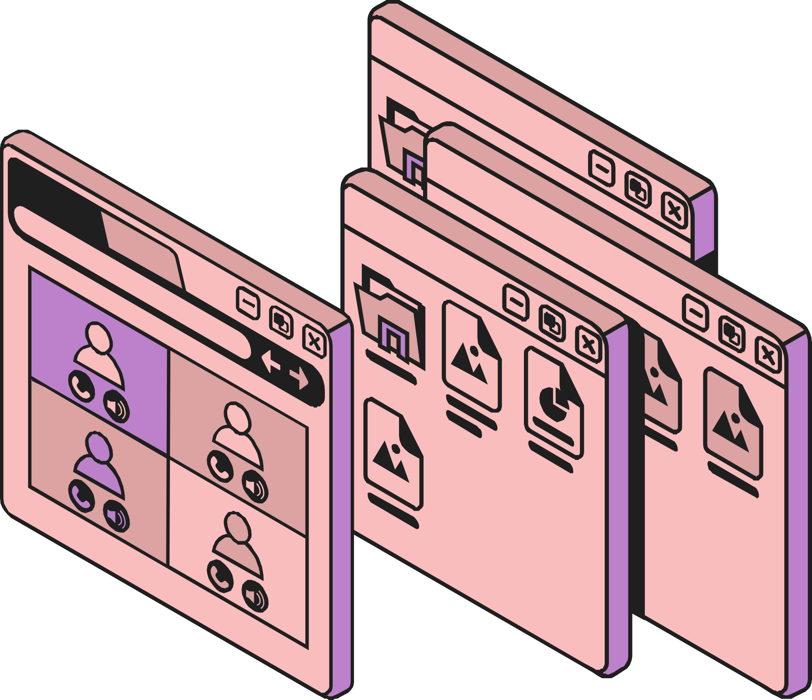
Technical Implementation
4.
API
The Web Speech API converts voice input into text.
5.
Android Application
A PWA builder is used to create the Android application.

Slide 9
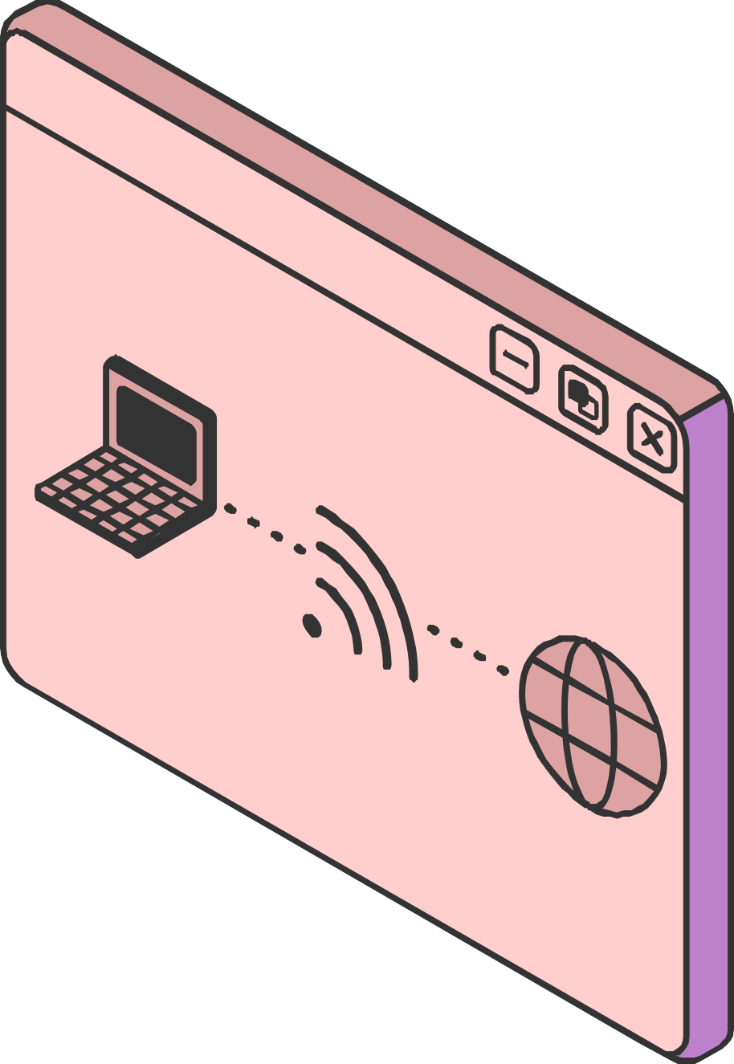
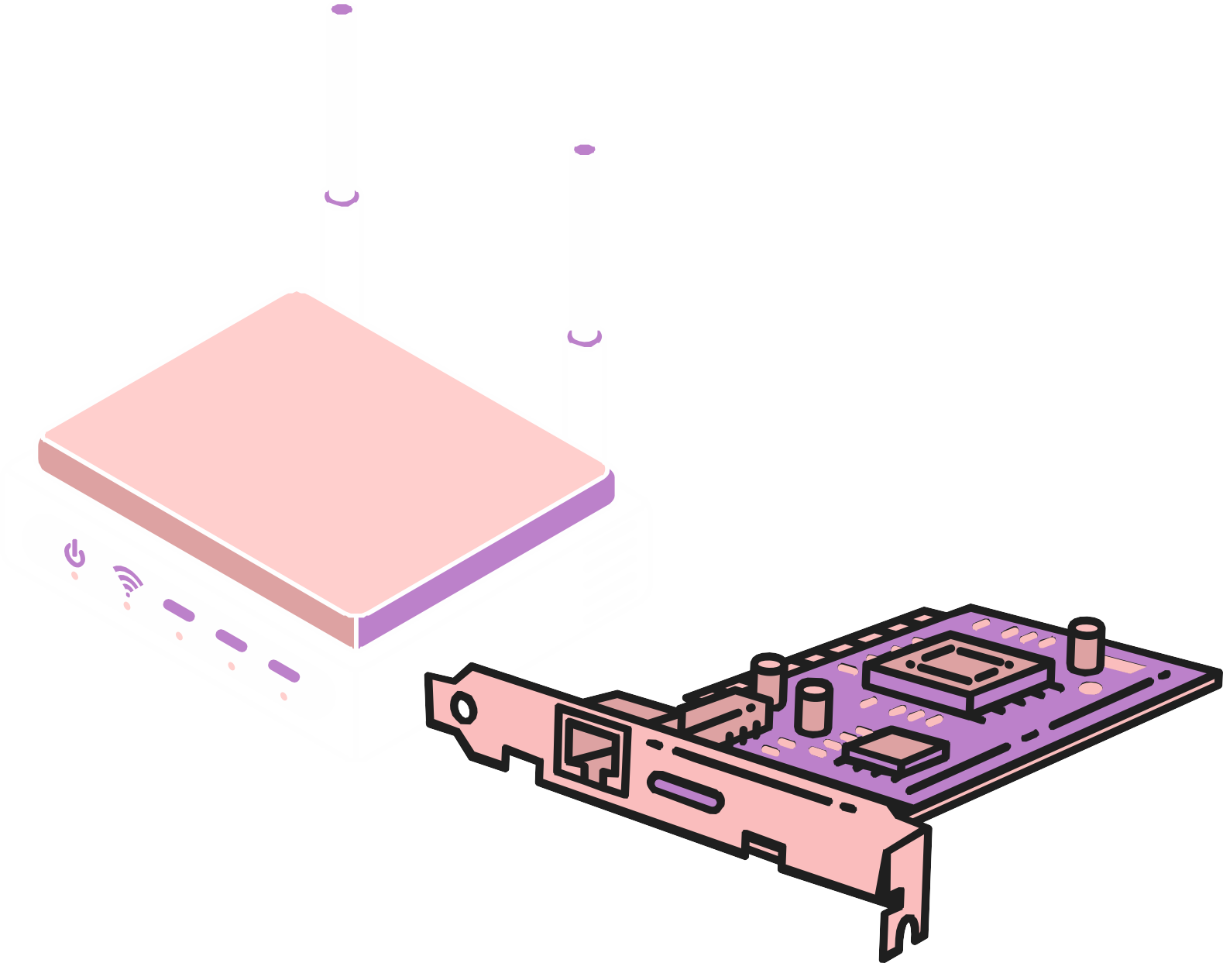
User Authentication Process
1
Login
Users authenticate with their email and password.
2
Sign In
Users authenticate to access their accounts and data securely.
3
Session Management
Secure session management protects user data and ensures authorized access.

Slide 10
Voice Input Functionality
Speech Recognition
Language Support
Noise Cancellation
The app uses speech recognition to convert speech into text.
The application supports Hindi language and converts into text as a combination of Hinglish .
Noise cancellation ensures accurate transcription in noise.

Slide 11
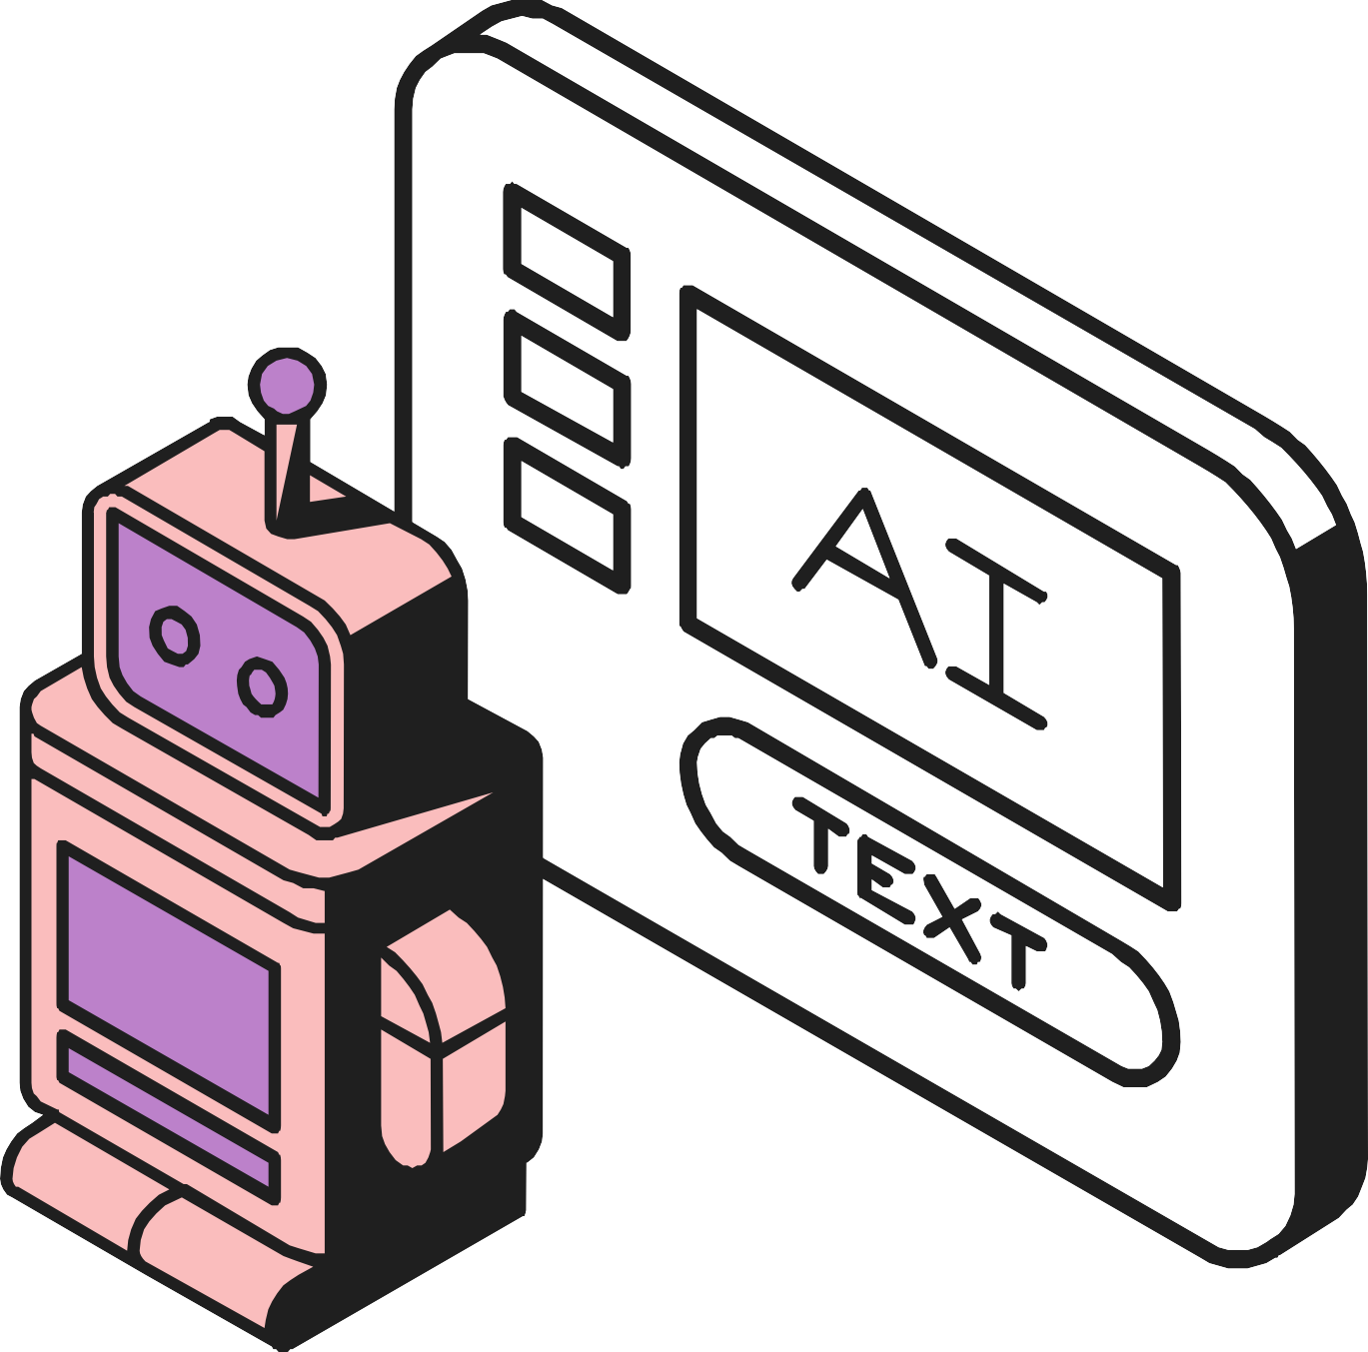
Impact on Productivity and Efficiency
Time Savings
Error Reduction
60%
Voice input speeds up form completion
85%
Speech recognition reduces typing errors
User Satisfaction
92%
Voice interaction enhances accessibility and user satisfaction

Slide 12

Advantages of the Voice-Enabled Bank Form Application:
Faster Form Completion – Voice input accelerates the process by
eliminating manual typing.
Error Reduction – Speech recognition minimizes typing mistakes and incorrect entries.
Improved Accessibility – Voice interaction makes forms accessible to
users with disabilities.
Enhanced User Experience – Streamlined, hands-free interaction makes form-filling more convenient.
Higher User Satisfaction – Easier and faster form submission increases
overall satisfaction.

Slide 13



Real-World Applications
Healthcare Documentation
Simplifies patient intake forms, medical histories, and other critical documentation.
1
Customer Service
Streamlines customer inquiries, feedback forms, and support requests.
2
Educational Surveys
Makes it easier for students and teachers to participate in surveys and assessments.
3

Slide 14
Future Improvements
Adaptive AI Learning
The system continuously learns and adapts to improve speech recognition accuracy and user experience.
1
Expanded Language Support
Support for additional languages and dialects will make the system more inclusive and accessible globally.
2
Personalized User Settings
3
Users can customize the system to match their preferences, such as voice recognition settings and form layouts.

Slide 15
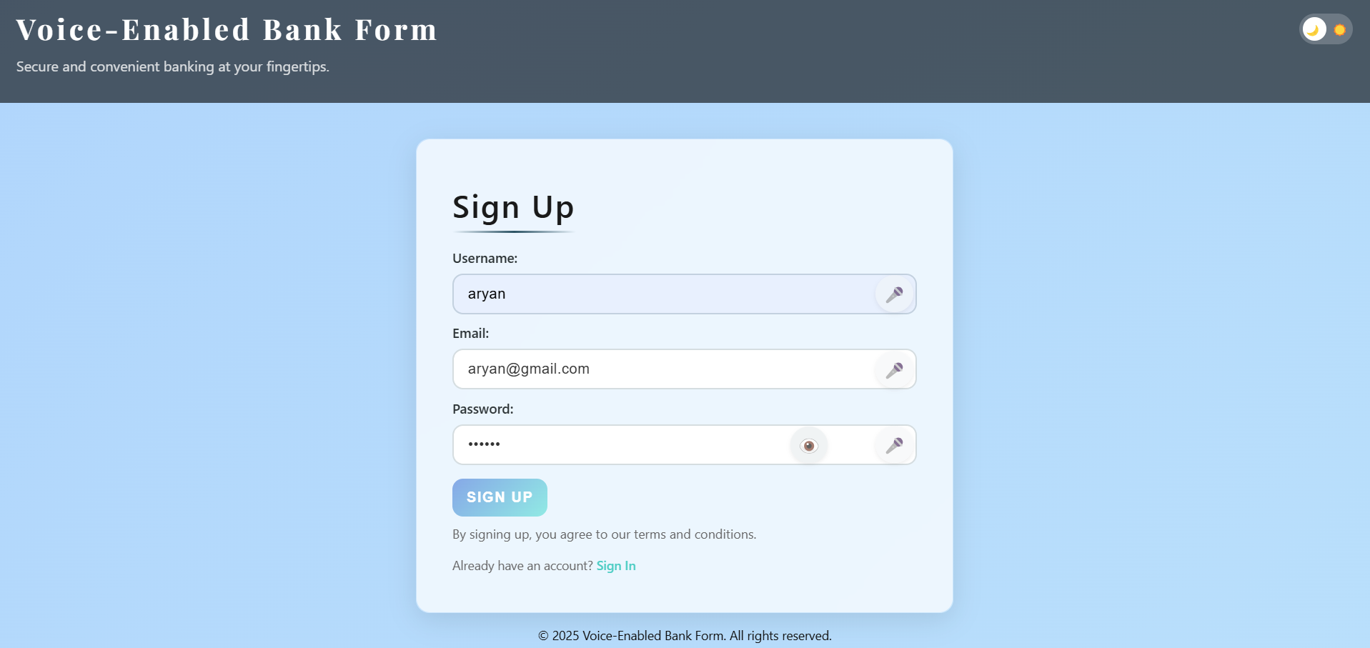
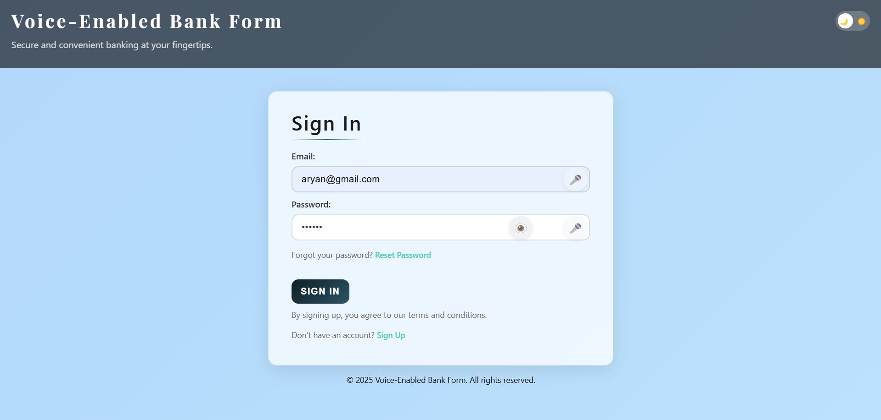
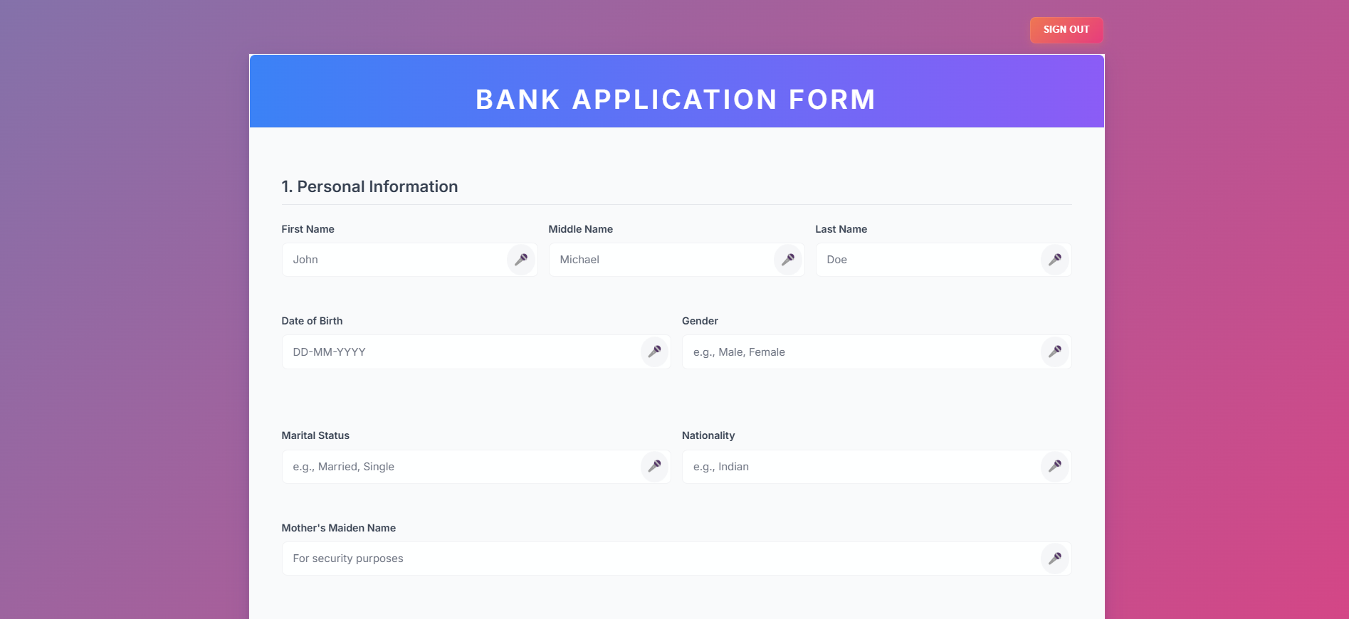
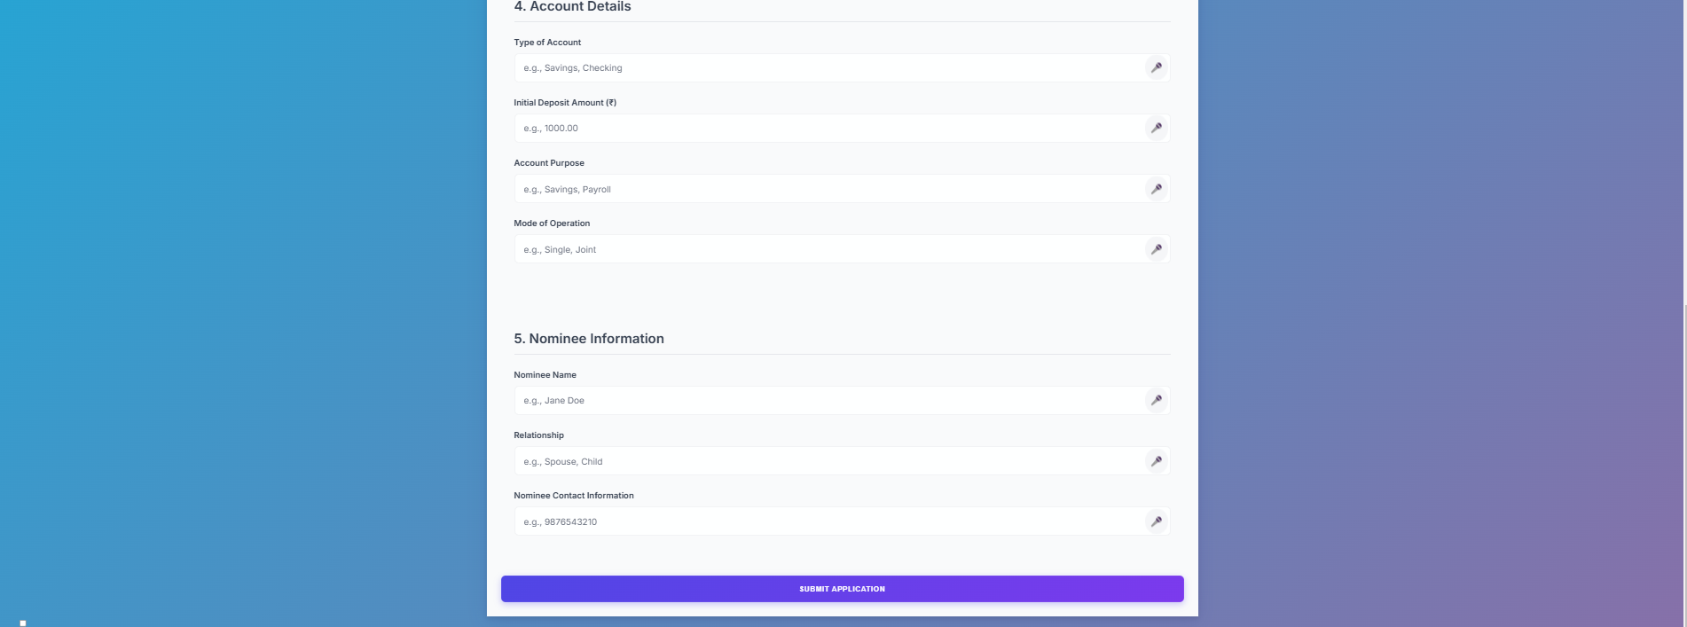

Slide 16


Conclusion
1
Transformation
Voice-based form filling streamlines data entry, making it faster and more efficient.
2
Productivity
Enhances accuracy, saving time and boosting productivity.
3
Experience
Provides a user-friendly and accessible experience, empowering users to complete tasks with ease.

Slide 17


THANK YOU

